Slide 1
Growth of Functions
Computer Science, Purdue University
Copyright McGraw Hill, Rosen, Discrete Mathematics and its Applications

Slide 2
Growth of Functions
Summary
Big-O Notation
Big-O Estimates for Important Functions
Big-Omega and Big-Theta Notation
Computer Science, Purdue University

Slide 3
Growth of Functions
Functions and their Growth Rates
In both computer science and in mathematics, there are many times when we care about how fast a function grows.
In computer science, we want to understand how quickly an algorithm can solve a problem as the size of the input grows.
We can compare the efficiency of two different algorithms for solving the same problem.
We can also determine whether it is practical to use a particular algorithm as the input grows.
Two of the areas of mathematics where questions about the growth of functions are studied are:
number theory
combinatorics
Computer Science, Purdue University

Slide 4
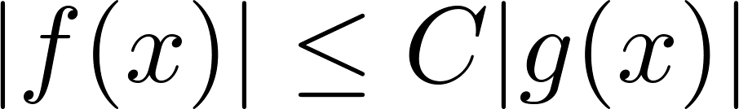
Growth of Functions
Big-O Notation
Definition: Let f and g be functions from the set of integers or the set of real numbers to the set of real numbers. We say that f(x) is O(g(x)) if there are constants C and k such that
whenever x > k. (illustration on next slide)
This is read as “f(x) is big-O of g(x)” or “g asymptotically dominates f.”
The constants C and k are called witnesses to the relationship f(x) is O(g(x)). Only one pair of witnesses is needed.
Computer Science, Purdue University

Slide 5
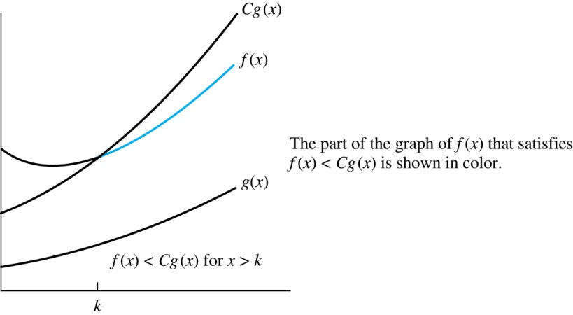
Growth of Functions
Illustration of Big-O Notation
Computer Science, Purdue University

Slide 6

Growth of Functions
Important Notes Regarding Big-O Notation
If one pair of witnesses is found, then there are infinitely many pairs. We can always make the k or the C larger and still maintain the inequality
Any pair C ̍ and k̍ where C < C̍ and k < k ̍ is also a pair of witnesses since
whenever x > k̍ > k.
You may see “ f(x) = O(g(x))” instead of “ f(x) is O(g(x)).”
But this is an abuse of the equals sign since the meaning is that there is an inequality relating the values of f and g, for sufficiently large values of x.
It is ok to write f(x) ∊ O(g(x)), because O(g(x)) represents the set of functions that are O(g(x)).
Usually, we will drop the absolute value sign since we will always deal with functions that take on positive values.
Computer Science, Purdue University

Slide 7
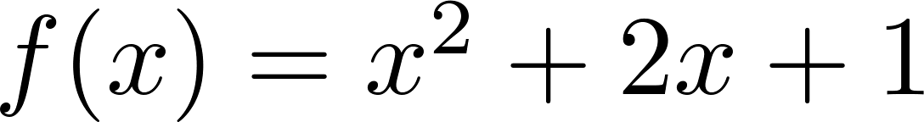
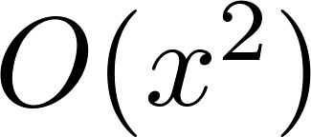
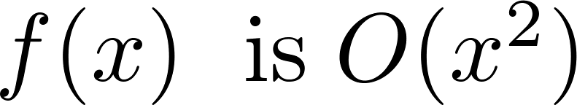
Growth of Functions
Using Big O Notation
Example: Show that is .
Solution: Since when x > 1, x < x² and 1 < x²
We can take C = 4 and k = 1 as witnesses to show that
(see graph on next slide)
Alternatively, when x > 2, we have 2x ≤ x² and 1 < x². Hence,
when x > 2.
Can take C = 3 and k = 2 as witnesses instead.
Computer Science, Purdue University

Slide 8
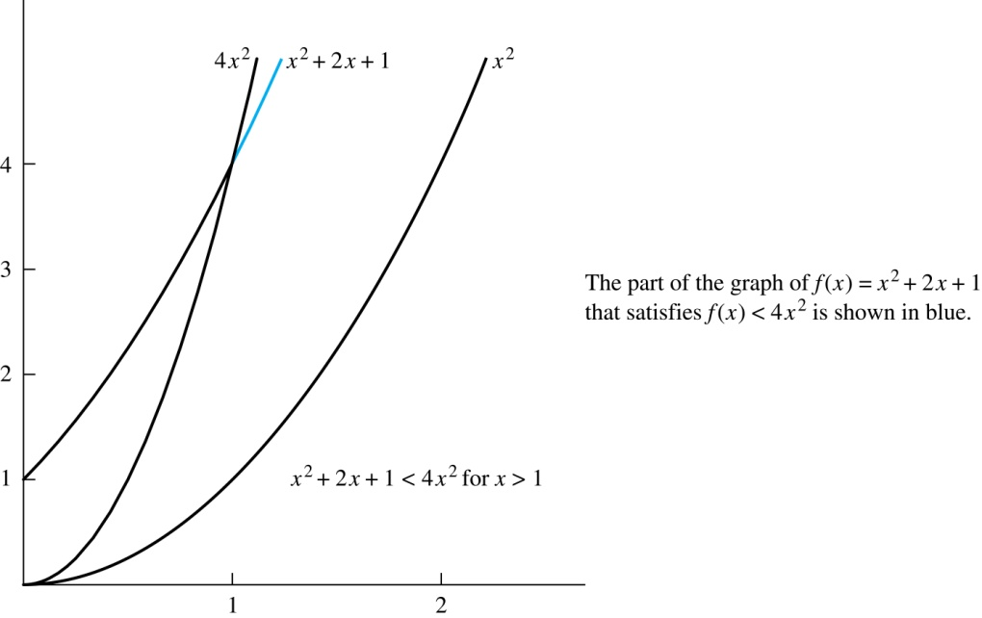
Growth of Functions
Illustration of Big-O Notation
is
Computer Science, Purdue University

Slide 9
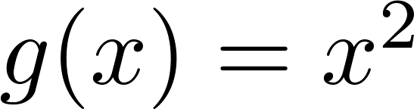
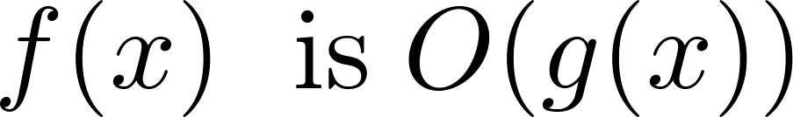

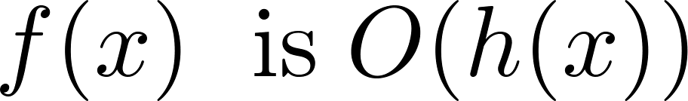
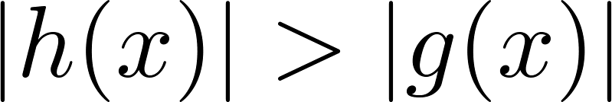
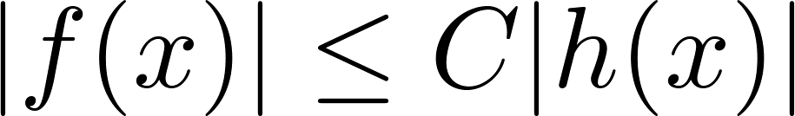
Growth of Functions
Big O Notation
Both and
are such that and .
We say that the two functions are of the same order. (More on this later)
If and h(x) is larger than g(x) for all positive real numbers, then .
Note that if for x > k and if
for all x, then if x > k. Hence, .
For many applications, the goal is to select the function g(x) in O(g(x)) as small as possible (up to multiplication by a constant, of course).
Computer Science, Purdue University

Slide 10
Thank You

